Slide 1
Exceptional Development: Dealing with Exceptions in .NET
Jason Bock
Practice Lead

Slide 2
Personal Info
http://www.magenic.com
http://www.jasonbock.net
https://www.twitter.com/jasonbock
https://www.github.com/jasonbock
jasonb@magenic.com

Slide 3
Downloads
https://github.com/JasonBock/ExceptionalDevelopment
https://docs.com/jason-bock/2431/exceptional-development

Slide 4
Overview
Motivation
Essentials
Recommendations
Summary
Remember…
https://github.com/JasonBock/ExceptionalDevelopment
https://docs.com/jason-bock/2431/exceptional-development

Slide 5
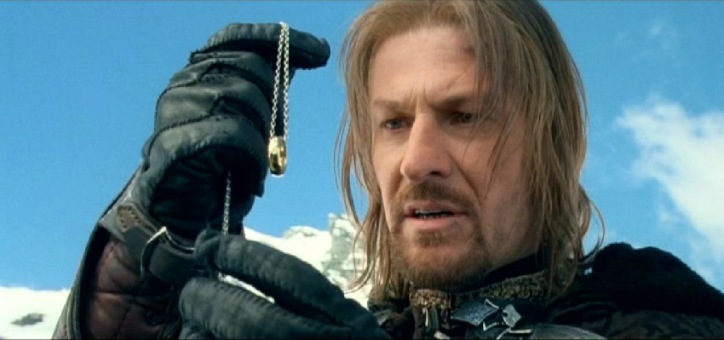
Motivation
http://smg.photobucket.com/user/ShirelingUK/media/JOURNEY/CH38/ringgoessouth74.jpg.html
Notes:
Exceptions…such a small thing. Yet I’ve seen them cause (or hide) so many unexpected problems and issues. I’ve also seem them abused badly in the name of “resilient” code. The following example is what finally got me to start doing a talk on this “small” thing. Note: this example came from a project I was on around 2007.

Slide 6
Motivation
public void AddPoints(List<DataPoint> points,
string pointGeneratorTypeName)
{
Type generatorType =
Type.GetType(pointGeneratorTypeName);
object generator =
Activator.CreateInstance(generatorType);
object[] arguments =
new object[] { startDate, endDate };
Notes:
This method’s sole purpose was to add medical data points to the given list. I’m posting it verbatim – we’ll judge it later ☺

Slide 7
Motivation
try
{
points.AddRange((List<DataPoint>)
generatorType.InvokeMember(
"GetDataPoints",
BindingFlags.InvokeMethod, null,
generator, arguments));
}
Notes:
This method’s sole purpose was to add medical data points to the given list. I’m posting it verbatim – we’ll judge it later ☺

Slide 8
Motivation
catch (Exception e)
{
// Note: don't change this message!
// Flash needs it!
throw (new Exception("Well-Known " +
"Web Service Connection Lost."));
}
}
Notes:
This method’s sole purpose was to add medical data points to the given list. I’m posting it verbatim – we’ll judge it later ☺

Slide 9
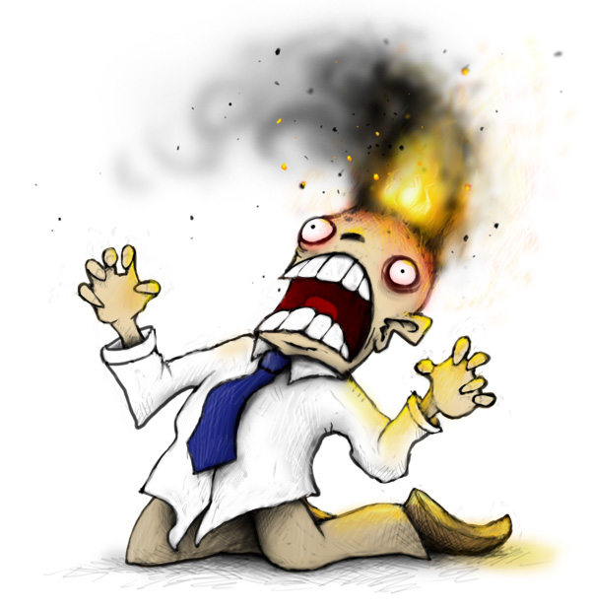
Motivation
http://www.plognark.com/Art/Sketches/Blogsketches/2008/thestupiditburns.jpg
Notes:
So, what made this so problematic?
Catching the general exception type – I have no idea what really failed (Reflection? Invoked method? The cast?)
The caught exception isn’t propagated as an inner exception
A new exception of type Exception is thrown – see 1st bullet point
Side note: Reflection is completely unnecessary – to make a long story short, a base interface with different implementations of point generators would have made all of this unnecessary

Slide 10
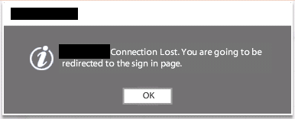
Motivation
Notes:
And here’s the end result. The page that shows a logged in user medical information may show data points. If none exist, it should simply not show anything. But the problem is that this exception causes the page’s logic to re-route back to the sign-in page. This was a critical bug that was caused by poor error and exception management.

Slide 11
Demo: Exception Essentials
Exceptional Development: Dealing with Exceptions in .NET
Notes:
In this demo, we’re going to cover the basics of exceptions
Exception class
InnerException – contains the root exception (can be null)
Message – a simple description providing more information
Source – the application that caused the exception
StackTrace – the call stack at the time of the exception
TargetSite – the method that threw the exception
Data – A key/value bucket of miscellaneous data
HelpLink – a link to a help file
Making Custom Exceptions
Derive from Exception
End with “Exception” suffix
[Serializable]
Provide four constructors
Use Code Snippets
Raising Exceptions
throw new {exception} – Creates a new exception and throws it
throw – Takes the exception caught in a handler and rethrows
Throw (use this one, not the other one)
throw {object reference}
Note: It’s legal to throw an object that does not inherit from Exception (although C# does not support this)
Handlers
Must have a try block (also known as a protected or guarded block)
Must have at least
1 or more catch handlers AND/OR
1 finally handler
Can add filter handlers with “when” keyword
In C#6, you can “await” in catch and finally blocks
No explicit support for fault handlers (C# will emit them)
Threads and Tasks
In 1.x, threads were “swallowed”
In 2.0 and beyond, an unhandled exception in a thread will terminate the process
In 4.5, this changes again
Tasks can also muddy the picture (see TaskSchedule.UnobservedTaskException event - https://msdn.microsoft.com/en-us/library/system.threading.tasks.taskscheduler.unobservedtaskexception(v=vs.110).aspx)
Configuration supports backwards compatibility
Keywords
using – expands to a try…finally that calls Dispose()
lock – expands to a try…finally that calls Monitor.Enter() and Monitor.Exit()
foreach – expands to a try…finally that calls Dispose() on the enumerator
checked – throws OverflowException on operations that…overflow ☺ (emits the .ovf version of the opcode)
Debugging
$exception is always available
Exception Handling (Debugging) window:

Slide 12
Recommendations
Use error codes (or tuples) to return expected conditions
TryParse() methods on structs
Use exceptions to communicate unexpected situations
Exceptions communicate rich information about errors
Exceptions cannot be (easily) ignored
Don’t return exceptions as error codes!
Notes:
For a long time, the mantra in .NET was “use exceptions”. But there are cases where using an error code isn’t a bad idea either, like TryParse(). However, if you didn’t expect something to happen that is “really bad” (that’s a whole discussion in and of itself) then use an exception.

Slide 13
Recommendations
var (result, error) = DoSomething();
if(!error.Exists)
{
// Work with result.
}
else
{
// Handle the error.
}
Notes:
Note that in C#7 (maybe, or at least a “future” C# version), tuples with the addition of an analyzer may help to enforce and handle error return values.

Slide 14
Recommendations
Testing
Unit, integration, end-to-end, QA, penetration, “chaos monkey”
Find the issues and solve them before production
Defensiveness
Use design-by-contract principles
Only throw and catch exceptions when necessary
It’s expensive
Cost is only incurred when exception is thrown
Notes:
Test, test, test. Developers will say, “well, I don’t know what that code will do” – well, write tests then! Be ruthless here. Vet out as much as you can.
Document data that you’ll accept in a method. Also state exceptions that might be thrown.
Exceptions are costly when thrown. That’s why TryParse() methods were introduced (their implementation is only 1 if statement different than the Parse() implementations).

Slide 15
Demo: Timing Exceptions
Exceptional Development: Dealing with Exceptions in .NET
Notes:
In this demo, you’ll see just how costly it can be to try and catch exceptions as Parse() forced you to do.

Slide 16
Recommendations
Avoid “try/catch/swallow” (TCS) patterns
try { /* ... */ }
catch { }
Why?
Application state is unknown
Doesn’t catch all (StackOverflowException in 2.0 is not catcheable)
No knowledge of exception is preserved
Notes:
Some developers will claim that this anti-pattern is “resilient” code because it will never crash. I used to see some dev shops have as a coding standard a requirement to put the TCS around the body of method, in EVERY method. Or, even worse, log the exception in every catch block, and then rethrow it (more often than not with “throw ex;”).
It is easy to get an application into a corrupted state if you do TCS – the upcoming demo will show this. It doesn’t even have to be something like low-level memory corruption. Just data being in an invalid and unexpected state.
This also doesn’t catch everything. StackOverflowException, among others, cannot be caught.
You have no idea why it failed unexpectedly. A severe error may have occurred, but you’ll keep on going.

Slide 17
Recommendations
StackOverflowException
ThreadAbortException
Corrupted State Exceptions (e.g. AccessViolationException)
Notes:
Here’s a list of exceptions that are difficult or “impossible” to catch:
StackOverflowException. Note, it can be caught if you’re hosting the CLR yourself, but that’s an extreme example
ThreadAbortException. It can be caught, but it’ll be re-raised after your catch block
CSEs, they can’t be caught unless you mark a method with [HandleProcessCorruptedStateExceptions]. There are other ways to do it via configuration, and it also depends on the security trust of the executed code.

Slide 18
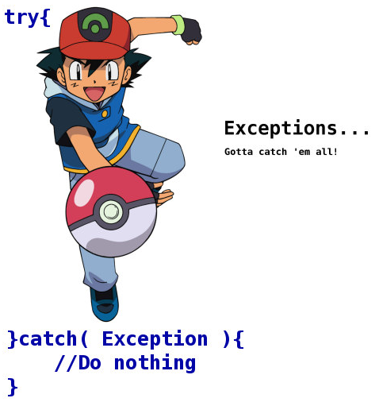
Recommendations
http://24.media.tumblr.com/tumblr_lpflmeeqfz1ql3fxto1_500.jpg
Notes:
This is also known as “Pokemon Exception Handling” – gotta catch ‘em all!

Slide 19
Recommendations
Only handle exceptions you can handle and recover from
Most of the time, this means you’ll hardly have any handlers
Use host events to hook unhandled exceptions
AppDomain – UnhandledException
ASP.NET – Global.asax, Application_Error
WPF – Application.DispatcherUnhandledException
WebAPI – ExceptionFilterAttribute, IExceptionLogger, IExceptionHandler
.NET Core – https://github.com/dotnet/corefx/issues/6398 (?)
Notes:
This is a hard one to believe. Most coders will say, “but my code can’t die! It has to stay running!” As we’ll see in a moment, the best thing to do is to stop immediately when something unexpected happens, and have retry or restart policies in place.
Case in point, I was on an application that was a complex load processing system. We had thousands of unit tests, lots of QA testing, lots of user acceptance testing, etc. We had only 6 “catch” blocks in the entire code base. That’s it. And this was an application that won awards in that company when it was released and received praises like “Other than a few minor issues which we were able to address, there were no problems. Ironically, we received a lot of positive feedback from users responding to the "unmonitored" email address which we use for outbound notifications. It was both enraging and delightful at the same time.” and “I'm definitely appreciative of the work you guys put in - you didn't cut corners and we're reaping the benefits now”.
You don’t need tons of exception handlers in your code. Only in the places where you know an exception may happen and you know how to recover from those specific ones.
You’ll always want some way to catch unhandled exception, if for anything to log the details before the process falls down (and you may want to restart it).

Slide 20
Demo: TCS and Alternatives
Exceptional Development: Dealing with Exceptions in .NET
Notes:
In this demo, we’ll look at the dangers of TCS and what you can do as alternatives.

Slide 21
Recommendations
Never throw the general Exception type
Don’t throw exceptions from finally handlers
Avoid throwing exceptions in type initializers – renders the type useless in that AppDomain
If you create a new exception in a catch block to throw, always chain the original exception as the InnerException
Use tools to help find exception-based issues (e.g. Code Analysis)

Slide 22
Demo: Using Tools
Exceptional Development: Dealing with Exceptions in .NET
Notes:
In this demo, we’ll take a look at Code Analysis and how this can help making exception handling different.

Slide 23

Summary
http://tolkien-world.com/forum/uploads/attachment/2013-04/1365544536_lord-of-the-rings-return-of-the-king.-special-extended-edition-3of3-(dvdrip.xvid.ac3.rus).0-46-26.444.jpg
Notes:
The path is clear – destroy bad exception handling practices.

Slide 24
Exceptional Development: Dealing with Exceptions in .NET
Jason Bock
Practice Lead
Notes:
Exceptional Development – References
Personal
Commercial Assembly Throws System.Exception All The Time - http://www.jasonbock.net/JB/Default.aspx?blog=entry.f63839d17a39452aa305e37a8724a31d
Disposable Object, ObjectDisposedException, and Sharing Disposable Objects - http://www.jasonbock.net/JB/Default.aspx?blog=entry.f40d569497f148f084cdf8a6fc93b3ac
ExceptionFinder for Reflector - http://www.codeplex.com/ExFinderReflector
ExceptionViews - http://www.codeplex.com/ExceptionViews
Interesting Exception Results: Throwing Exceptions From the Finally Block - http://www.jasonbock.net/JB/Default.aspx?blog=entry.194f2a132ce34de3bfcf9953de1caab7
StackOverflowException - http://www.jasonbock.net/JB/Default.aspx?blog=entry.3daabf90e7d94c82bbff9d923ad457d3
Throwing Exceptions That Are Not Exceptions - http://www.jasonbock.net/JB/Default.aspx?blog=entry.9d6dbbd00d294f6fa2fee35f03e56ae8
Others
.NET Anatomy - Structured Exception Handling in .NET - http://www.dotnetjunkies.ddj.com/Tutorial/030F9042-C48A-4210-9977-0425C231BF75.dcik
A Crash Course on the Depths of Win32™ Structured Exception Handling - http://www.microsoft.com/msj/0197/exception/exception.aspx
A Look at Exceptions in .NET Applications - http://www.simple-talk.com/dotnet/.net-framework/a-look-at-exceptions-in-.net-applications/
Are you getting an IOException on Path.GetTempFileName()? Debugging tells you it's creating an empty ("") filename in the exception? - http://www.pchenry.com/Home/tabid/36/EntryID/125/Default.aspx
But all my errors are severe! - http://particular.net/blog/but-all-my-errors-are-severe
C# Exception Handling - https://msdn.microsoft.com/en-us/magazine/mt620018.aspx
Catch, Rethrow, and Debuggability - http://blogs.msdn.com/jmstall/archive/2007/02/07/catch-rethrow.aspx
Catch, Rethrow and Filters - Why you should care? - http://blogs.msdn.com/clrteam/archive/2009/02/05/catch-rethrow-and-filters-why-you-should-care.aspx
CodeSOD: Avoiding the Exception - http://thedailywtf.com/Articles/Avoiding-the-Exception.aspx
CLR Exception Handling And Memory Management Presentation - http://www.microsoft.com/downloads/details.aspx?familyid=7421bca5-1efc-41fc-989f-d112144f5561&displaylang=en
CLR exception handling from A to Z - Everything you didn't want to know about try-catch-finally-fault-filter - http://bartdesmet.net/blogs/bart/archive/2006/04/04/clr-exception-handling-from-a-to-z-everything-you-didn-t-want-to-know-about-try-catch-finally-fault-filter.aspx
Configuring Visual Studio to Debug .NET Framework Source Code - http://blogs.msdn.com/sburke/archive/2008/01/16/configuring-visual-studio-to-debug-net-framework-source-code.aspx
Defensive Programming, or Why Exception Handling Is Like Car Insurance - http://leedumond.com/blog/defensive-programming-or-why-exception-handling-is-like-car-insurance/
Diagnosing Errors with Managed Debugging Assistants - http://msdn.microsoft.com/en-us/library/d21c150d(VS.80).aspx
Did you know… You can examine the exception object from the exception assistant? - #275 - http://blogs.msdn.com/saraford/archive/2008/08/06/did-you-know-you-can-examine-the-exception-object-from-the-exception-assistant-275.aspx
Dispose, Finalization, and Resource Management - http://www.bluebytesoftware.com/blog/2005/04/08/DGUpdateDisposeFinalizationAndResourceManagement.aspx
Evil Exception Handling - http://panteravb.com/blog/posts/2008/10/29/evil-exception-handling.ashx
Exception Data Evolved - http://blog.freakcode.com/2010/12/exception-data-evolved.html
Exception Filter - http://blogs.msdn.com/junfeng/archive/2008/12/08/exception-filter.aspx
Exception Handling - http://msdn.microsoft.com/en-us/library/vstudio/ms229005(v=vs.100).aspx
Exception-Handling Antipatterns - http://today.java.net/article/2006/04/04/exception-handling-antipatterns
Exception Handling – the Pokemon Way - http://forums.thedailywtf.com/forums/p/8499/161761.aspx
Exception Handling Best Practices - http://www.codeproject.com/KB/architecture/exceptionbestpractices.aspx
Exception Handling Advice for ASP.NET Web Applications - http://www.4guysfromrolla.com/articles/081209-1.aspx
Exception Handling in .NET (some general guidelines) - http://musingmarc.blogspot.com/2005/09/exception-handling-in-net-some-general.html
Exceptions: The Airbags of Code - http://blogs.msdn.com/cdndevs/archive/2009/08/04/exceptions-the-airbags-of-code.aspx
Exceptions out of Fault/Finally - http://blogs.msdn.com/clrteam/archive/2009/03/23/exceptions-out-of-fault-finally.aspx
Exceptional Series
Throwing exceptions in different ways - http://www.pchenry.com/Home/tabid/36/EntryID/121/Default.aspx
Performance impacts with Exceptions - http://www.pchenry.com/Home/tabid/36/EntryID/124/Default.aspx
Alternative error handling mechanism for Exceptions - http://www.pchenry.com/Home/tabid/36/EntryID/123/Default.aspx
Exceptionally Mysterious - http://www.simple-talk.com/dotnet/.net-framework/exceptionally-mysterious/
Execution Engine Architecture - http://www.ssw.uni-linz.ac.at/Teaching/Lectures/Sem/2001/Literatur/Architecture.doc
Experiments With the CLR Exception Handling Mechanism - http://www.inf.ethz.ch/personal/fruja/publications/clrexctests.pdf
FAQ: Why does FxCop warn against catch(Exception)?
Part 1 – https://blogs.msdn.microsoft.com/codeanalysis/2006/06/15/faq-why-does-fxcop-warn-against-catchexception-part-1-nick-guerrera/
Part 2 – https://blogs.msdn.microsoft.com/codeanalysis/2006/06/18/faq-why-does-fxcop-warn-against-catchexception-part-2-nick-guerrera/
Part 3 – https://blogs.msdn.microsoft.com/codeanalysis/2006/06/20/faq-why-does-fxcop-warn-against-catchexception-part-3-nick-guerrera/
FAQ :: TaskScheduler.UnobservedTaskException event doesn’t work? - http://blogs.msdn.com/b/pfxteam/archive/2010/08/06/10046819.aspx
Finally! - http://thedailywtf.com/Articles/My-Tales.aspx
First and second chance exception handling - http://support.microsoft.com/kb/105675
Four Ways to Test Expected Exceptions - http://nunit.com/blogs/?p=63
Friends Don’t Let Friends catch (Exception) – http://leedumond.com/blog/friends-dont-let-friends-catch-exception/
Getting more information than the exception class provides - http://blogs.msdn.com/clrteam/archive/2009/06/19/getting-more-information-than-the-exception-class-provides.aspx
The good and the bad of exception filters - http://blogs.msdn.com/clrteam/archive/2009/08/25/the-good-and-the-bad-of-exception-filters.aspx
Good Exception Management Rules of Thumb - http://www.hanselman.com/blog/GoodExceptionManagementRulesOfThumb.aspx
The Greatest Exception Handling WTF?!? of All Time - http://leedumond.com/blog/the-greatest-exception-handling-wtf-of-all-time/
Handling Corrupted State Exceptions - http://msdn.microsoft.com/en-us/magazine/dd419661.aspx
Handling “Unhandled Exceptions” in .NET 2.0 - http://www.julmar.com/blog/mark/PermaLink,guid,f733e261-5d39-4ca1-be1a-c422f3cf1f1b.aspx
Handling Exceptions - http://www.developer.com/tech/article.php/3370341
How CLR maps SEH exceptions to managed exception types - http://blogs.msdn.com/clrteam/archive/2009/05/14/how-clr-maps-seh-exceptions-to-managed-exception-types.aspx
How Do You Deal With Exceptions? - http://www.codethinked.com/post/2009/05/14/How-Do-You-Deal-With-Exceptions.aspx
How To Disable “A first chance exception of type…” Messages in VS 2005 - http://www.helixoft.com/blog/archives/24
How to Handle .NET Unhandled Exceptions Gracefully - http://blogs.msdn.com/lexli/archive/2009/04/28/how-to-handle-net-unhandled-exceptions-gracefully.aspx
Improved Unhandled Exception Behavior in .NET 2.0 - http://www.codinghorror.com/blog/archives/000216.html
Integrating Exception Handling Into the Development Cycle - http://leedumond.com/blog/integrating-exception-handling-into-the-development-cycle/
Let The CLR Find Bugs For You With Managed Debugging Assistants - http://msdn.microsoft.com/en-us/magazine/cc163606.aspx
.NET Framework 4 Migration Issues - http://msdn.microsoft.com/en-us/library/ee941656%28VS.100%29.aspx (specifically, look at the “Exceptions” section)
Making Catch, Rethrow more debuggable - http://blogs.msdn.com/jmstall/archive/2007/02/12/making-catch-rethrow-more-debuggable.aspx
Managed code and asynchronous exception hardening - http://www.bluebytesoftware.com/blog/2009/03/13/ManagedCodeAndAsynchronousExceptionHardening.aspx
Managed Debugging Assistants in VS2005 - http://cs.rthand.com/blogs/blog_with_righthand/archive/2006/05/13/648.aspx
Modeling the .NET CLR Exception Handling Mechanism for a Mathematical Analysis - http://www.jot.fm/issues/issue_2006_04/article1/
Part 1 - http://blogs.msdn.com/fxcop/archive/2006/06/14/FAQ_3A00_-Why-does-FxCop-warn-against-catch_2800_Exception_29003F00_-_2D00_-Part-1-_5B00_Nick-Guerrera_5D00_.aspx
Part 2 - http://blogs.msdn.com/fxcop/archive/2006/06/17/FAQ_3A00_-Why-does-FxCop-warn-against-catch_2800_Exception_29003F00_-_2D00_-Part-2-_5B00_Nick-Guerrera_5D00_.aspx
Part 3 - http://blogs.msdn.com/fxcop/archive/2006/06/19/FAQ_3A00_-Why-does-FxCop-warn-against-catch_2800_Exception_29003F00_-_2D00_-Part-3-_5B00_Nick-Guerrera_5D00_.aspx
Partition Documents - http://msdn.microsoft.com/en-us/netframework/aa569283.aspx
Partition I – Section 10.5, “Exceptions”
Partition II – Section 19, “Exception handling”
Partition III
Section 4.24, “rethrow”
Section 4.31, “throw”
Reader Challenge – Fault Handlers in C# - http://community.bartdesmet.net/blogs/bart/archive/2009/12/06/reader-challenge-fault-handlers-in-c.aspx
Sample Reflection.Emit code for using exception filters from C# - http://blogs.msdn.com/rmbyers/archive/2010/01/30/sample-reflection-emit-code-for-using-exception-filters-from-c.aspx
“Secure Programming with Static Analysis” (specifically, Chapter 8: “Errors and Exceptions”)
Should you catch System.Exception? - http://www.aaron-powell.com/blog/december-2008/should-you-catch-systemexception.aspx#
Simple Main - http://www.wintellect.com/CS/blogs/jclark/archive/2005/03/30/simple-main.aspx
Some finalizer pitfalls - http://feeds.feedburner.com/~r/AyendeRahien/~3/348393371/Some-finalizer-pitfalls.aspx
Some Managed/Unmanaged Exception Tricks - http://www.atalasoft.com/cs/blogs/stevehawley/archive/2008/09/11/some-managed-unmanaged-exception-tricks.aspx
Task Exception Handling in .NET 4.5 - http://blogs.msdn.com/b/pfxteam/archive/2011/09/28/10217876.aspx
TDD and Fail Code - http://blog.wekeroad.com/blog/tdd-and-fail-code/
The Error Model - http://joeduffyblog.com/2016/02/07/the-error-model/
This…is…Dynamic! - http://msdn.technetweb3.orcsweb.com/curth/archive/2008/07/31/this-is-dynamic.aspx
Throw Before You Yield - http://weblogs.asp.net/okloeten/archive/2008/08/25/6564322.aspx
To throw or rethrow? - http://bartdesmet.net/blogs/bart/archive/2006/03/12/3815.aspx
Understanding and Using Exceptions - http://codebetter.com/blogs/karlseguin/archive/2006/04/05/142355.aspx
Unhandled Exception Processing in the CLR - http://msdn.microsoft.com/en-gb/magazine/cc793966.aspx
VB Catch ... When: Why so special? - http://blogs.msdn.com/vbteam/archive/2008/10/09/vb-catch-when-why-so-special.aspx
Vexing Exceptions - http://blogs.msdn.com/ericlippert/archive/2008/09/10/vexing-exceptions.aspx
WCF and Faults - http://blogs.msdn.com/drnick/archive/tags/Faults/default.aspx
What is a First Chance Exception? - http://blogs.msdn.com/davidklinems/archive/2005/07/12/438061.aspx
Why catch(Exception)/empty catch is bad - http://blogs.msdn.com/clrteam/archive/2009/02/19/why-catch-exception-empty-catch-is-bad.aspx
Wrapping non-CLS exceptions - http://www.bluebytesoftware.com/blog/CommentView,guid,3663a39f-72ed-4d40-a4d0-c3fbd3d12716.aspx
Writing Reliable Code - http://msdn.microsoft.com/en-us/magazine/cc163298.aspx

